Slide 1
A- Presentation of MySQL , PostgreSQL and SQL SERVER :
1- MySQL : MySQL is a relational database management system (RDBMS) developed by Oracle that is based on structured query language (SQL). MySQL is integral to the most popular software stacks for building and maintaining everything from customer-facing web applications to powerful, data-driven B2B services. Its open-source nature, stability, and rich feature set, paired with ongoing development and support from Oracle. Internet-critical organizations such as Facebook, Flickr, Twitter, Wikipedia, and YouTube all employ MySQL backends.
2-PostgreSQL : PostgreSQL is a powerful, open-source object-relational database system that uses and extends the SQL language combined with many features that safely store and scale the most complicated data workloads. PostgreSQL has earned a strong reputation for its proven architecture, reliability, data integrity, robust feature set, extensibility, and the dedication of the open-source community behind the software to consistently deliver performant and innovative solutions. PostgreSQL runs on all major operating systems, is ACID-compliant, and has powerful add-ons such as the popular PostGIS geospatial database extender.
2-SQL SERVER : SQL Server is a relational database management system, or RDBMS, developed and marketed by Microsoft. Similar to other RDBMS software, SQL Server is built on top of SQL, a standard programming language for interacting with the relational databases. SQL server is tied to Transact-SQL, or T-SQL, Microsoft’s implementation of SQL that adds a set of proprietary programming constructs.

Slide 2
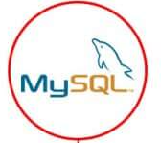

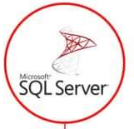
B- Comparison between MySQL, PostgreSQL and SQL SERVER :
 | My SQL | Postgre SQL | SQL Server
Price | Has additional paid tools; ths core functionality can be accessed for free. | Open-source | The database has a free edition for devlopers and small businesss but only supports 1 processor and 1 memory GB. For a server,users need to pay $931.
Language | Written in C++,database management is done with structred Query Language. | Written in C. | Written in C, C++.
Data changes | A solution updates data automatically to the rollback storge. | Developers insert a new column and row in order to update the database. | The database has three engines that are responsible for row updates.
Defragmentation | Offers several approaches to defragmentations – during backup, index creation , and with an optimize table command. | Allows scanning the entire tables of data layer to find empty rows and delete the unnecessary elements. | Offers an efficient garbage collector that doesn’t create more than 15-20% of overhead.

Slide 3
 | My SQL | Postgre SQL | SQL Server
Data queries | Offers a scalable buffer pool-developers can set up the size of the cache according of the workload. | Each database has a separate memory and runs its own process. | Uses a buffer pool,and just like in MySQL, it can be limited or increased according to processing needs.
Temporary tables | Offers limited functionality for temporary tables (devlopers cannot set variables or create global templates) | Developers divide temporary tables on local and global,configure them with flexible variables. | Devlopers can create local and global temporary tables, as waell as oversee and create variables.
Indexes | Indexes are organized in tables and clusters. | Supports index-based table organization, but the early versions don’t include automated index updates (it appears after the release of the 11th edition) | Indexes can be organized in clusters and maintain the correct ros order without manual involvement.
Memory-optimized tables | Supports the memory-stored tables, but they can’t participate in transactions, and their security is highly vulnerable. | Doesn’t supports in-memory table creation. | Memory-optimized tables can participate in transactions together with ordinary tables.

Slide 4
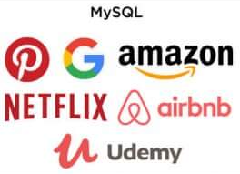
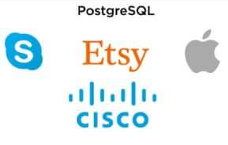
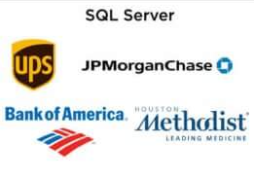
 | My SQL | Postgre SQL | SQL Server
Json support | Supports JSON files but dosen’t allow indexing them. | Supports JSON files, as well as their indexing and partial updates. | Provides full support of JSON documents,their updates, functionality, maintenance.
Partitioning | Allows partitioning databases with hashing functions in order to distribute data among several nodes. | Allows making LIST and RANGE partitions where the index of a partition is created manually. | Provides access to RANGE partitioning, where the partition is assigned to all values that fall into a particular range.
Companies that use :

